Slide 1
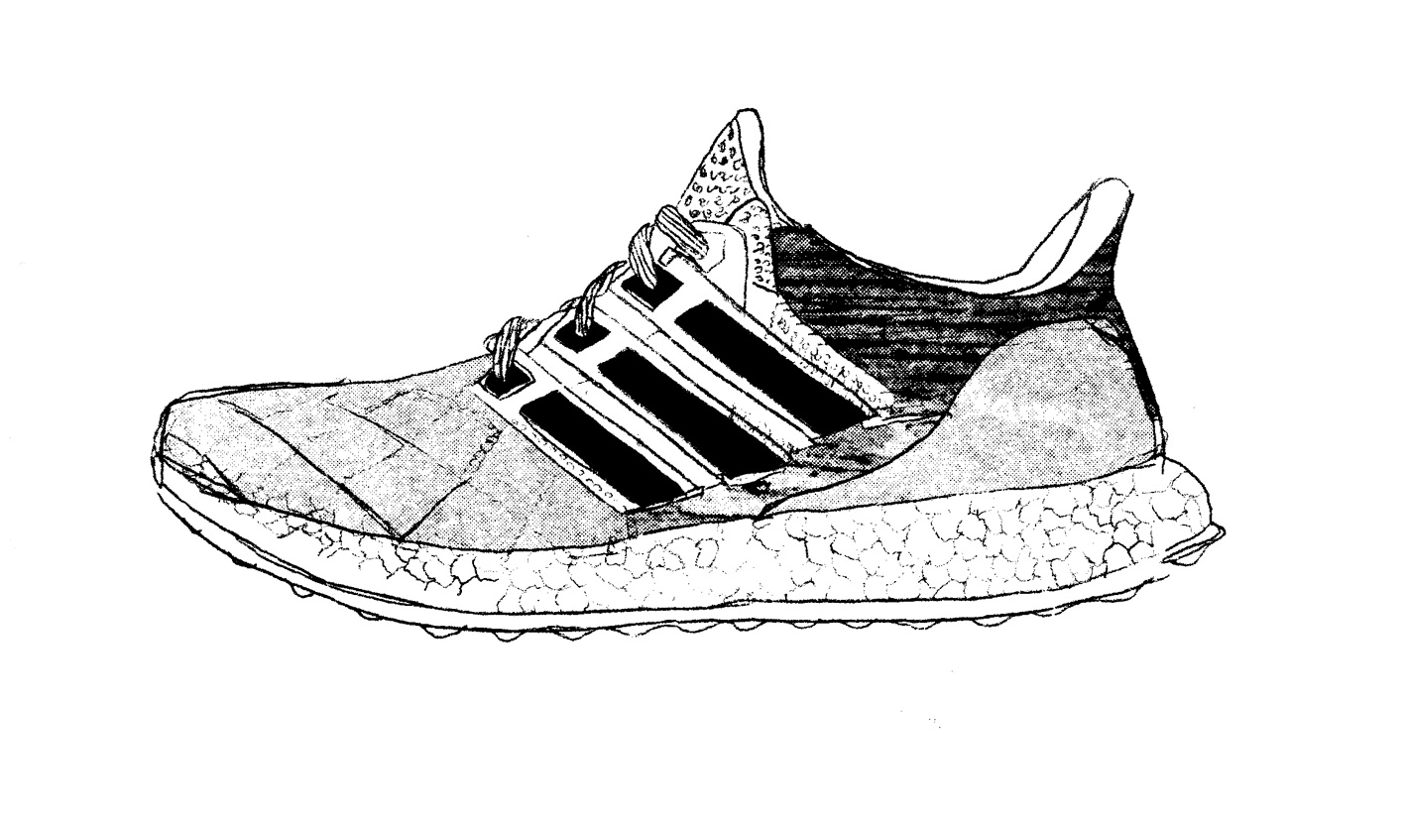

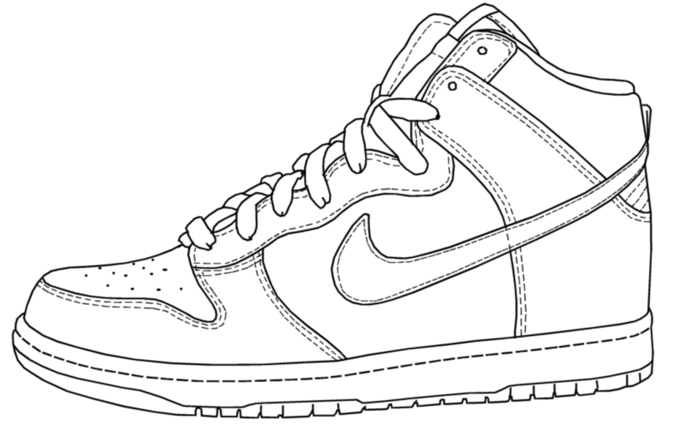
Project 1: SneakerHub
Kevin Tse /
Julie Huang
WDI 37

Slide 2
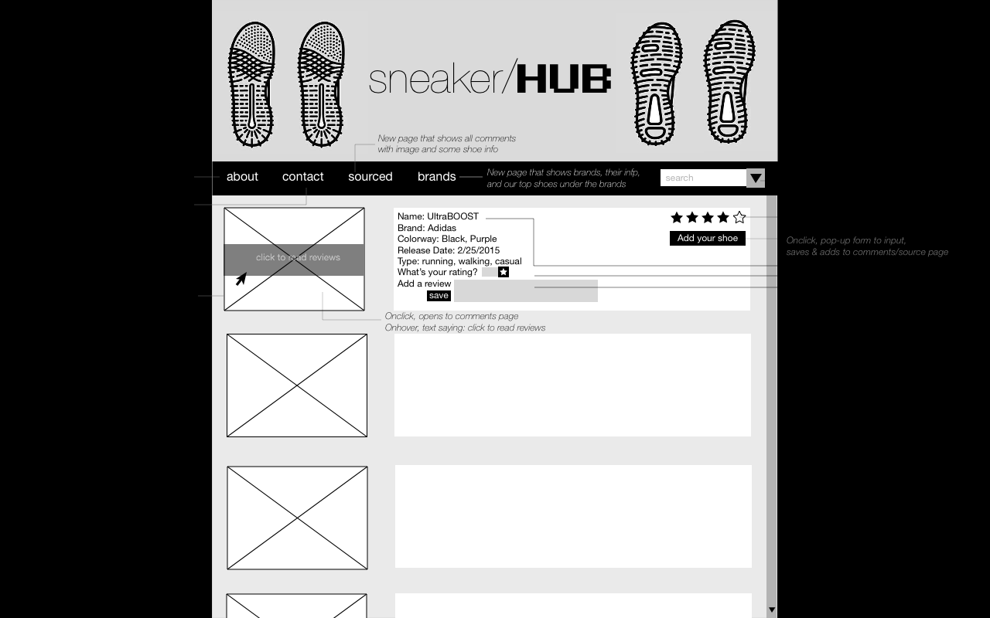
WIREFRAMES: Main Page

Slide 3
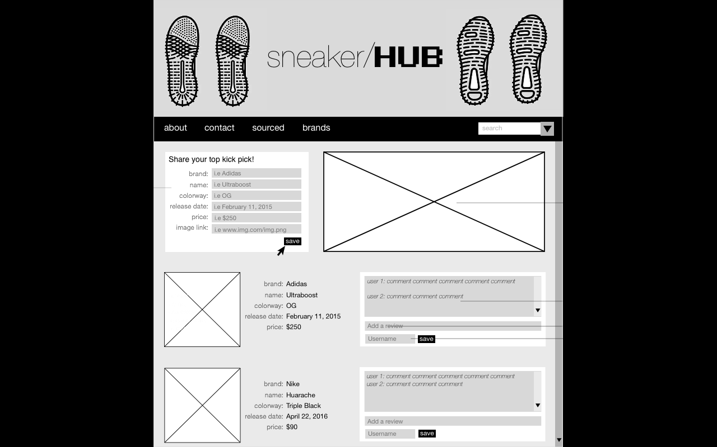
WIREFRAMES: Source Page

Slide 4
WIREFRAMES: Brands Page

Slide 5
FRONT END
HTML
CSS
Materialize
App.js
Appsource.js

Slide 6
BACK END
Server
AJAX
Models
Shoe.js
Brand.js
Index.js
Seed

Slide 7
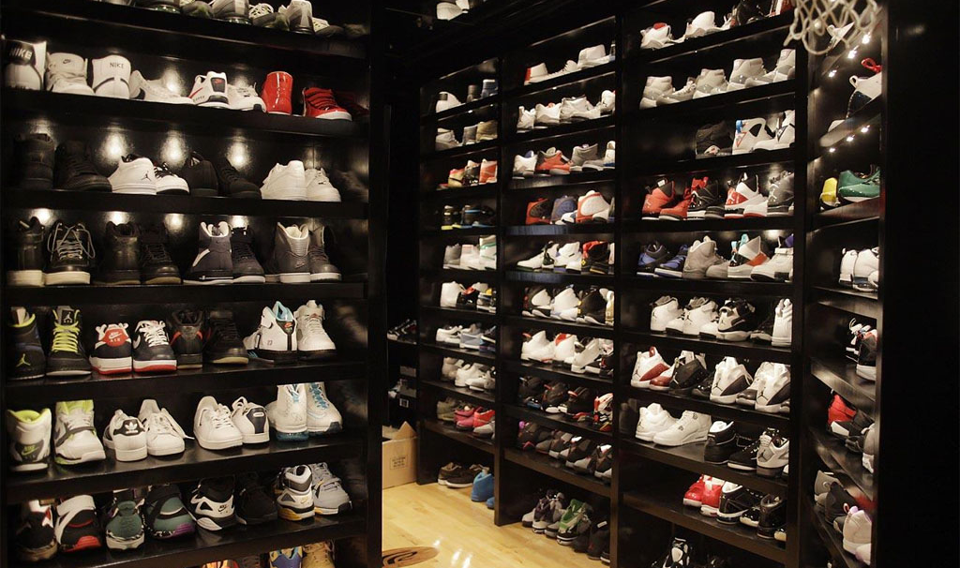
QUESTIONS?

